Slide 1



Welcome to Capgemini
Day 1
Capgemini America Inc.
Financial Services Strategic Business Unit
Oct 2019

Slide 2


Ground Rules
Everyone participates
Be open and honest
One speaker at a time
Stick to time lines
Clean room policy
No mobile phone,
No computer (except when required)
Notes:
Best to print on an A3 sheet and display in class. The idea is to co-create, to connect to learn, to do-learn-do (knowing is not enough, the real purpose is to apply what we learn on the job). It would also be great to have the class share their learning with their teams. You are the facilitator, you will help all share knowledge and learn new concepts or skills, there will be no lectures, everyone is a teacher.

Slide 3

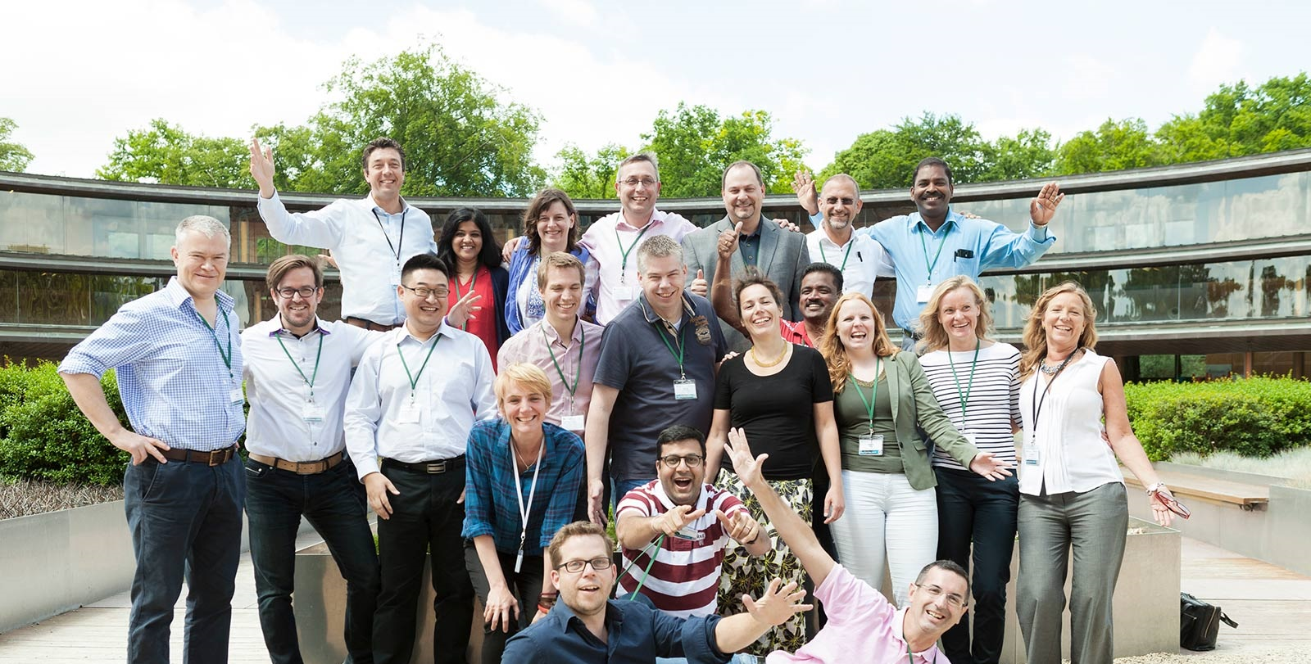
Very glad to meet you, welcome to Capgemini!
Please introduce yourself
A little more about you…
Tell us about your professional experience
Notes:
Live twitter handle is an option if tech supports it. If there 10 attendees, this will take up

Slide 4



On-Boarding Objectives
To help you settle down in Capgemini, feel comfortable, make friends. Understand the business, culture and values of the company
Be engagement ready
Understand how we support you to excel and grow at Capgemini
Have enough information and insight to build a network of contacts across the business line
Be aware that you 'know who to contact' should you need help
Look forward to a great experience in Capgemini
Notes:
Time on clock:

Slide 5

Questions ?
Anything we missed?
I would really like to know how…
Can you tell us more about…
Will you be covering…
Notes:
Time on clock:

Slide 6


Agenda: Day 1
Who we are: Capgemini Group Overview
What we will do together:
Welcome to the FS SBU family
What we stand for: Capgemini Values Workshop
Lunch
Systems, Processes & Tools: how to find your way around
Benefits for you
Your Growth & Career at Capgemini

Slide 7
Agenda: Day 2
How we deliver: Lifecycle of work in Capgemini FS
Break out time for new hires to troubleshoot tools, etc
Lunch
90-day Plan

Slide 8
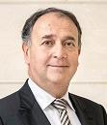

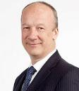
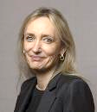
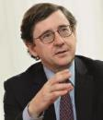
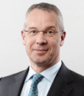
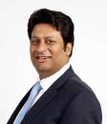

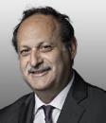
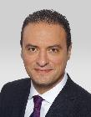
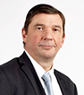



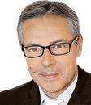
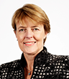
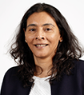
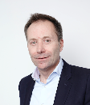
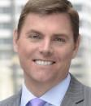
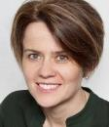
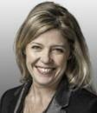
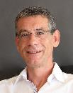
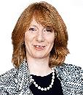
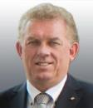
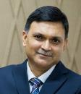
Group Executive Committee (As of January 2019)
GEB
members
Paul Hermelin
Aiman Ezzat
Thierry Delaporte
Carole Ferrand
Hubert Giraud
Patrick Nicolet
Anirban Bose
Olivier Sevillia
Jean-Philippe Bol
Group Chairman & CEO *
Chief Operating Officer*
Chief Operating Officer *
Chief Financial Officer
Human
Resources
Chief Technology Officer
Financial Services
Europe
A&A
Anis
Chenchah
André Cichowlas
Jean Coumaros
Pierre-Yves Cros
Cyril Garcia
Franck Greverie
Christine Hodgson
Aruna Jayanthi
GEC
members
Business Services
Delivery
Transformation
Strategy & Development
Capgemini Invent
Portfolio
Corporate & Social Responsibility
Asia Pacific and Latin America
Paul
Margetts
John Mullen
Maria
Pernas
Virginie Régis
Jerome Simeon
Rosemary Stark
Hans van Waayenburg
Ashwin
Yardi
United Kingdom
Business Unit
North America
Business Unit
Group General Counsel
Marketing & Communications
France
Business Unit
Sales
Netherlands
Business Unit
India
* Office of the CEO

Slide 9
Our brand embodies
who we are
Human, dynamic and precise.
Our brand identity shows our true nature and our difference.
We are proud of carrying a 50 year legacy into the future, through technology with a human touch.
People matter, results count.

Slide 10
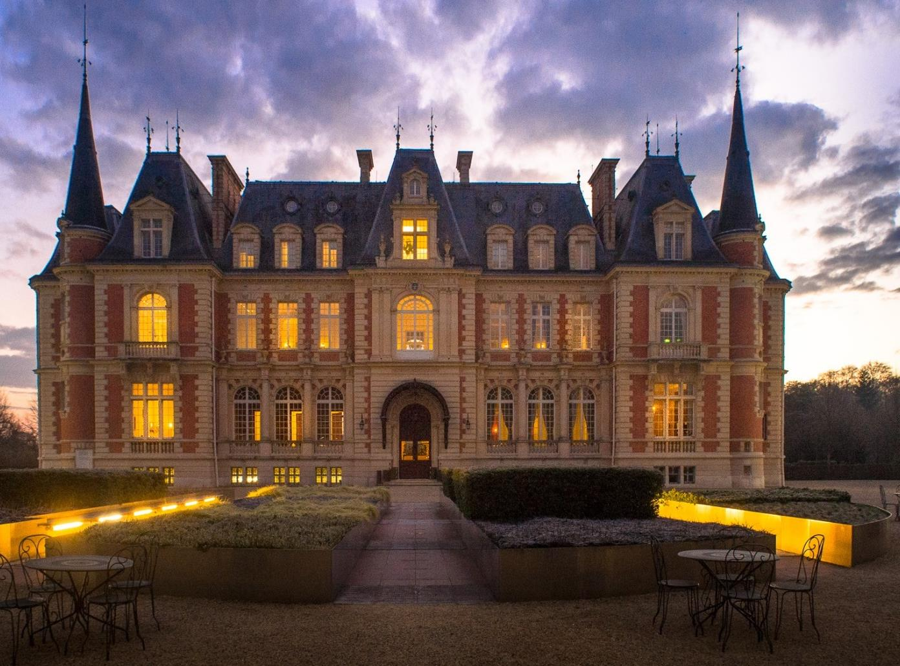

Capgemini: 50+ years strong
Startup
1967
7 people in Grenoble, France
2019
Global Leader
210,000+ employees
44 countries presence
13.2 B € annual turnover
25 innovation centers
6,000+ clients
Capgemini’s Les Fontaines Campus in France

Slide 11


Slide 12

In a rapidly changing business climate
Our 7 foundation values
Freedom
Trust
Team Spirit
Our Values
guide our business decisions and shape our culture
Boldness
Modesty
Honesty
Fun
www.capgemini.com/about/group/values-ethics
© Capgemini 2019. All rights reserved |

Slide 13

From purpose ...to creating impact
Our Vision
The business value of technology comes
from and through people
Our Mission
With you, we create and deliver business and technology solutions that fit your needs and drive the results you want
Group Presentation | November 2017

Slide 14
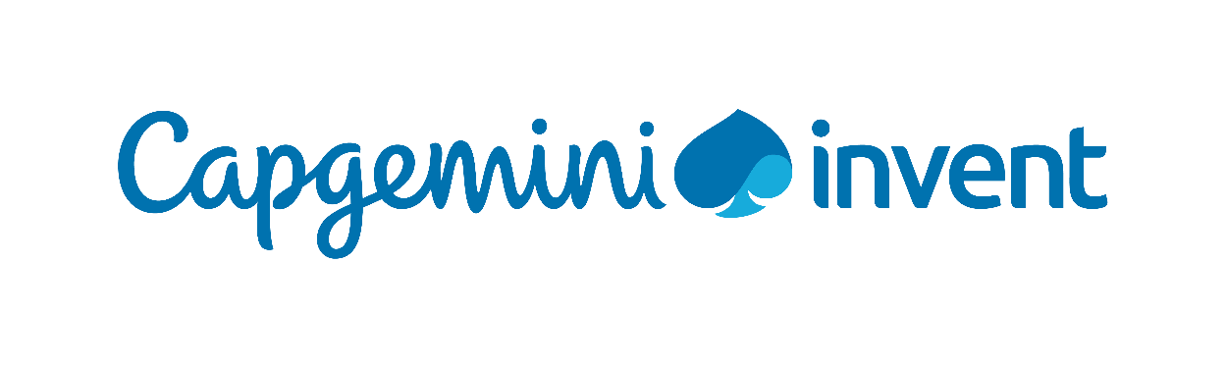

A complete range of businesses
We are 210 000 people passionate about helping our clients solve their most complex business and technology challenges, and we deliver transformational outcomes, at scale.
We are driven by the conviction that the business value of technology comes from and through people
Capgemini Invent is the Group’s digital innovation, consulting and transformation brand.
They bring to life what’s next for their clients by combining strategy, technology, data science and creative design.
Sogeti is the Group’s proximity technology brand. They know how to make value from technology and work closely, at a local level, with their clients to deliver technology services for infrastructure, applications, engineering, testing and operations.

Slide 15
With breadth of expertise across Capgemini sector groupings …
Consumer Products, Retail & Distribution
Telecom, High-Tech, Media & Entertainment
Manufacturing
Energy &
Utilities
Financial
Services
Public
Sector
Consumer Products
Retail & Wholesale
Distribution & Logistics
Aerospace & Defense
Automotive
Life Sciences
Other Manufacturing
Energy & Renewables
Utilities
Chemicals
Natural Resources
Telecoms
High-Tech
Media & Entertainment
Banking & Capital Markets
Cards and payments
Retail banking and Wealth Management
Commercial banking and diversified financial services
Insurance
Property and Casualty
Life
Healthcare
Education & Research
Public Security & Police
Tax & Welfare
Public Healthcare
Other government

Slide 16
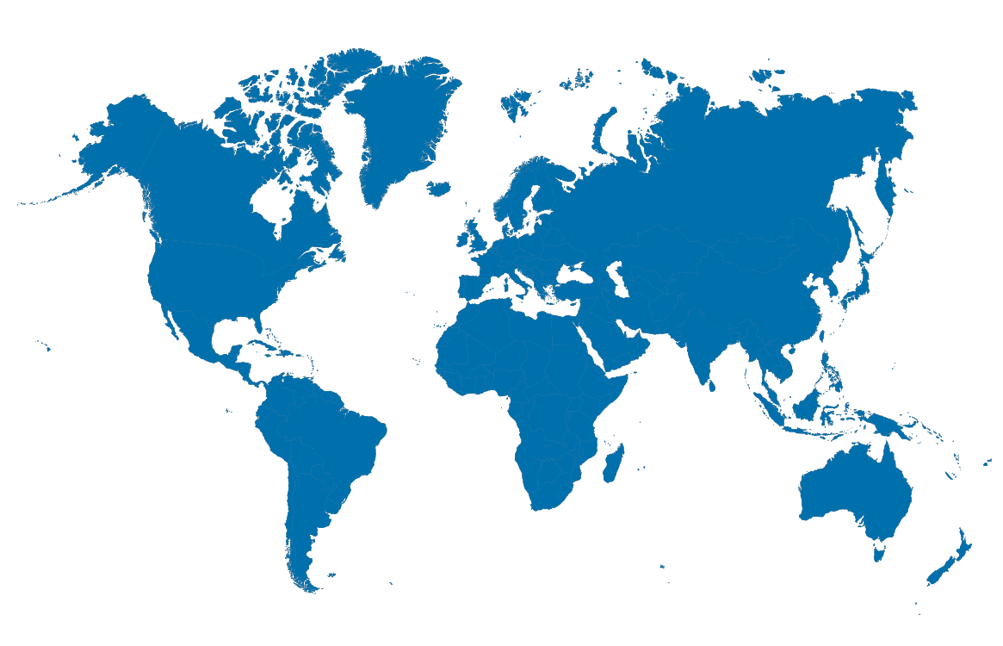
We have a competitive global delivery model
The right balance to global delivery and sourcing
Cost Reductions
Streamlined Processes
Innovation
Leveraging the right Talent and the latest Technology to deliver you the future.
As One Team, we help you become more competitive. Anywhere. Anytime.
to do more with less while staying competitive
to improve productivity and compliance
to transform your business
Competitive Advantage
Growth
Automation
to improve quality and predictability with the latest technology
with solutions that expand your business
to drive agility and cut time-to-market with new ways of working

Slide 17

Market recognitions
Positioned:
As a Leader, for the first time, in the ALM Vanguard: Innovation Strategy Consulting
(Mar. 2018)
As a Leader in the Gartner Magic Quadrant for CRM and Customer Experience Implementation Services, Worldwide
(Jan. 2018)
As a Leader in the Gartner Magic Quadrant for Data and Analytics Service Providers, Worldwide
(Feb. 2018)
As a Leader in the NelsonHall Software Testing - Digital Testing NEAT
(Nov 2017)
Update coming early-2019
2018
As a Leader
in the NelsonHall GDPR Services NEAT Overall (May 2018)
#2 in the HFS Top 10 RPA service providers 2018, based on Execution, Innovation, and Voice of the Customer
(Nov. 2018)
As a Leader in the Gartner Magic Quadrant for SAP Application Services, Worldwide
(Feb. 2018)
2017
*Gartner Disclaimer:
Gartner does not endorse any vendor, product or service depicted in its research publications, and does not advise technology users to select only those vendors with the highest ratings or other designation. Gartner research publications consist of the opinions of Gartner’s research organization and should not be construed as statements of fact. Gartner disclaims all warranties, expressed or implied, with respect to this research, including any warranties of merchantability or fitness for a particular purpose.
(x) See Notes Page for sources
Notes:
*Gartner Disclaimer:
Gartner does not endorse any vendor, product or service depicted in its research publications, and does not advise technology users to select only those vendors with the highest ratings or other designation. Gartner research publications consist of the opinions of Gartner’s research organization and should not be construed as statements of fact. Gartner disclaims all warranties, expressed or implied, with respect to this research, including any warranties of merchantability or fitness for a particular purpose.
ALM Intelligence: “The ALM Vanguard: Innovation Strategy Consulting,” Nathan Simon, 14 March 2018
Gartner Inc.: “Magic Quadrant for CRM and Customer Experience Implementation Services, Worldwide,” Patrick Sullivan, Ed Thompson, 8 January 2018
Gartner Inc., “Magic Quadrant for Data and Analytics Service Providers, Worldwide,” Jorgen Heizenberg, Neil Chandler, Twiggy Lo, 28 February 2018
NelsonHall: “GDPR Services NEAT,” Mike Smart, 2 May 2018
HFS: “HFS Top 10 RPA Service Providers 2018,” Elena Christopher, Maria Terekhova, 1 November 2018
Gartner Inc.: “Magic Quadrant for SAP Application Services, Worldwide,” Fabio Di Capua, Kris Doering, Susan Tan, 26 February 2018
NelsonHall: “Software Testing: Digital Testing NEAT,” Mike Smart, 1 November 2017

Slide 18

2018 Group Performance
Annual 2018
Revenue
€13,197
million
Energy, Utilities & Chemicals
Revenue by Business
Financial Services
Public Sector
Others
Manufacturing,
Automotive & Life Sciences
Revenue by Industries
Telecom, Media & Entertainment
Application Services
Other Managed Services
Consumer Product, Retail, Distribution & Transportation
Technology and
Engineering Services
Consulting Services
Notes:
Annual Results to be updated

Slide 19




We are “Architects of Positive Futures”, using our expertise for positive social and environmental impact
Diversity
Digital inclusion
Environmental
sustainability
Leverage a global work environment where diverse profiles and inclusive practices are instrumental to our collective performance
Spread the digital culture
and become Role-model in bridging the digital gap
Minimize our business-related environmental impacts, and provide support to clients with sustainability challenges
2020
TARGETS
25%
of executive
leadership to be
women.
34%
of our total
workforce to be
women.
80%
of our social impact
initiatives to be focused on Digital Inclusion.
20%
reduction in carbon emissions per employee compared to 2015.
Employee engagement
Excite and train employees, recognize individual and team action,
connect expertise through global networks

Slide 20







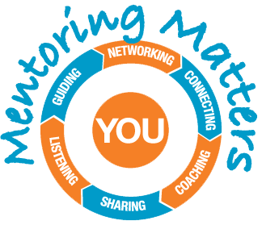



Engagement through Employee Resource Groups (ERGs)
Capgemini NA endorses 11 Employee Resource Groups (ERGs) that support inclusion across North America. An ERG is a network of colleagues with a common purpose. ERGs support having a work culture of mutual respect for differences, enabling people to collaboratively deliver innovative solutions.
Build consulting skills
Build client relationships
Network internally and externally
Gain business experience
Accelerate career growth
Enable partner and employer of choice goals
Influence Capgemini commerce, culture, career and community
Serve your community
Capgemini’s Employee Resource Groups (ERG) engage over 2,000 team members
Notes:
Our Employee Resource Groups promote diversity and inclusion, while generating business opportunities and contributing to employee development. We cultivate a work culture of mutual respect for differences, enabling people to collaboratively deliver innovative solutions.
Capgemini currently endorses 11 Employee Resource Groups (ERGs) in North America. An ERG is a network of colleagues with a common purpose. Any employee can join an employee resource group or create a new employee resource group (with appropriate approvals). Currently there are over 2000 NA employees who participate in one of our Employee Resource Groups (ERG). Retention rates for employees involved in an ERG is higher than the average NA retention rate overall.
ERGs objectives are aligned with a concept referred to as the 4C’s. The 4C’s are:
Commerce
Culture
Career
Community
Activities planned by the ERGs must connect with 1 or more of the $4C’s to ensure maximum benefit to employees and the business. Now I will share the missions of the ERGs and highlight some of their key activities.
A³ (Pronounced A cubed) – The mission of A³ To further the development of diversity & inclusion within Capgemini, as well as promote Capgemini’s core values, with emphasis on the African American community. The African-American and African Employee Resource Group is focused on networking, mentoring, awareness, recruitment and retention among those who are interested in African American and African culture.
AbiliNet ‘s mission is to provide a network of support for employees with special needs, employees supporting family members who are disabled and employees supporting aging parents with special needs. This year, AbiliNet will host webinars to educate employees on issues impacting those with special needs.
CARES (Community Action, Responsibility, and Environmental Sustainability) – The mission of CARES is to enhance, support and advance Capgemini’s community engagement and environmental sustainability while providing resources to individual employees to pursue the areas of corporate responsibility and sustainability that are important to them. In addition to supporting a number of local office community projects, some hosted in partnership with other ERGs, CARES drives efforts in:
Community Programs;
Environmental Sustainability;
Recruitment & Retention; and
Pro Bono Consulting Projects.
CREATE is Capgemini’s Asian Employee Resource Group. The acronym stands for Collaborating to Reach Excellence in Asian Talent & Expertise. This ERG’s focuses around the three goals of COMMUNITY, LEADERSHIP, and BUSINESS GROWTH. HOLA – is the ERG focused on the career development needs of our Hispanic/Latino employees. HOLA’s mission is to promote a mutually beneficial integrations of strengths that exist between Hispanic/Latino and non-Hispanic/Latino members of Capgemini. HOLA, along with its peer Employee Resource Groups, seeks to provide forums and activities for Awareness, Development, Service, Networking, Recruitment and Retention. HOLA’s logo, the clasped hands are not just to signify a greeting, it’s the hand up to get our employees started on journey of growth and opportunity.
LIFE (Life Integration for Everyone) is Capgemini’s newest ERG. LIFE seeks to share information and resources to help harmonize the different dimensions of life.
LIFE’s objectives are to:
Raise awareness on new and innovative resources to support an improved lifestyle
Provide forums for employees and leaders to share their concerns, knowledge and experiences on wellness related matters
Organize community events that encourage and support employees in leading integrated and productive lives
Mentoring Matters – the mission of Mentoring Matters is to strengthen and develop employee networks, provide guidance related to the attainment of career and personal aspirations, and foster a culture of coaching and a sense of inclusion. In 2016, Mentoring Matters strives to increase participation in its program through:
The recruitment of Mentors;
Training and Development;
The engagement with other ERGs which have made mentorship a priority; and
Collaboration across Capgemini NA to offer more support of other mentor programs that exist.
Millennial Innovation Council (MIC) – MIC is an employee resource group with the purpose of encouraging collaboration across generations by providing a community for millennials to innovate, create, and lead at Capgemini. We build this community through local events and national projects that encourage coast-to-coast collaboration. Some past local events we’re hosted include Escape the Room, Professional Photo Day, and Gardening Community Service. Last year we also hosted the Perception and Presence Workshop, which was our first national workshop that took place in all 5 chapters across the country. Some of our past national projects include developing Prezi content for recruitment, creating a monthly MIC Newsletter, and recording episodes for the MIC Podcast Series.
OUTfront – The mission of OUTfront is to provide a forum for education and awareness supporting the professional growth of LGBTA (Lesbian, Gay, Bisexual, Transgender, and Allies) individuals by fostering a safe environment within Capgemini North America for individuals to be authentic in the workplace.
VERG (Veteran’s Employee Resource Group) – The mission of VERG is to encourage and assist Veterans in pursuing and building careers in various fields at Capgemini while employing the skills, experience, talent and dedication they bring, as well as providing opportunities to the families of Veterans as a tribute to their service.
VERG’s objectives for 2016 are:
Recruitment: Leverage partnerships with Veteran organizations in order to place Veterans in positions with Capgemini
Development: Provide key training and assistance for Veterans adapting to the Capgemini culture while enabling ongoing career development for existing Veteran employees
Honor: Show respect to Veterans and military families by raising awareness of Veteran’s causes and actively supporting Veteran’s initiatives both online and in the community
Growth: Leverage the internal and external VERG networks in order to add business value and increase business growth
Women LEAD is a network for all Capgemini colleagues (women and men) in North America who want to build and promote a community of people who respect each other’s skills and experience regardless of gender. It enables the communication of: women’s focused activities, the value these activities/initiatives have for the greater good of Capgemini, and the positive impact to our business.
Women LEAD will continue to focus around the 4Cs: Culture, Career, Commerce and Community. As a community we will increase alignment with Women@Capgemini; interviewing senior leaders for their perspectives in addition to supporting the active local offices with their activities. To create further impact for our members’ careers, we will be engaging with the Women Leadership Development Program (WLDP) while also creating the “What’s in it for me” model, which strengthens the commercial business case. Women LEAD serves as a sponsor for Capgemini’s Lean In Chapter. Lean In Circles are small groups who meet regularly to learn and grow together.
Again, we encourage all employees to leverage their unique talents to become involved in, or support an ERG.
Join an ERG;
Offer a training/presentation to an ERG;
Attend ERG sponsored events/webinars and encourage others to do the same;
Share information about ERGs to new employees and recruits; and
Recognize employees who you work with for their support of ERG.
Email inclusion.nar@capgemini.com with the ERG that you are interested in getting involved with, and the CR team will connect you to the ERG Leaders.
Ways to engage and what's in it for you!
Develop communication, presentation, and networking skills through ERG programs
Build your network internally and externally through events (e.g., Hackathon, Women In Digital)
Discover additional avenues to achieve your career goals through ERG involvement
Influence Commerce, Culture, Career and Community at Capgemini in a measurable way
Build relationships with clients through synergies on corporate responsibility goals
Gain experience that may be useful in a future project role
Drive sustainable initiatives in North America that support our employer of choice and partner of choice goals
Impact the communities in which we live and work through service

Slide 21


Connect with us
Visit our website
Keep up to date on social media
capgemini.com
Discuss innovations with our specialists
Follow the best of business and technology news
capgemini.com/experts
content-loop.com
Learn about tomorrow’s tech trends and innovation
capgemini.com/beyond-the-buzz

Slide 22

Up Next! What we will do together: Welcome to the FS SBU family!

